Slide 1
Using a DBMS
420-D10 Database I
References:

Slide 2
Objectives
Understand
client/server model of DBMS
how data is structured in a DBMS
Skills
How to find data in a database

Slide 3
Objectives
Understand
how data is structured in a DBMS
Table format
Multiple tables
Keys
Skills
Add, modify, delete data in a paper database

Slide 4
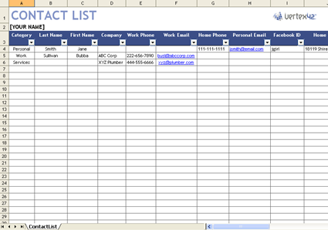

Recall: Organizing data
Contact list
Last name, first name, phone number, skypeId
To Do list
Task description, priority, due date, status
Top 10 movies
Title, genre, opening year, box office gross
Humans naturally understand how to organize data into lists/tables
Each row is typically describes a unique instance of something
This in it’s simplest form, is a database.

Slide 5
Remember Excel?
Spreadsheet
Rows – records with multiple columns
Columns – a single attribute or value
Tbd excel example of student list
Note each row is a student
Each column is an attribute
A specific row/column is the attribute for that specific student
Notes:
We’re just using Excel as an example of a flat table structure, it could be any flat structure (non-relational)

Slide 6
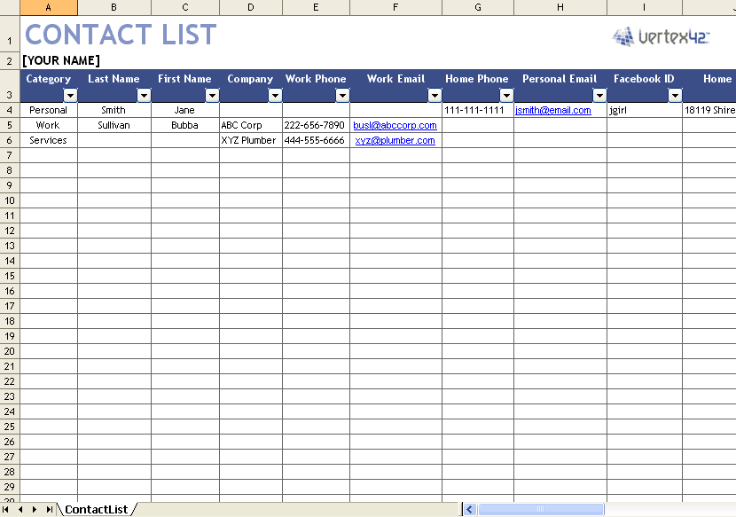

Software operations in Tables
Add/delete row
Modify row entry
Need to precisely identify a row: that’s the “key”
Pick elements in the row that makes that row unique
Single or compound “keys”
“modify the phone number where lastName is Chan, firstName is Richard”
Design challenge: what guarantees uniqueness?
Notes:
To automate this with software we have to be precise on how to organize and find data
Discussion:
Create a contact list table, identify all the columns
For the contact list, what would be

Slide 7

Example Use Case: Hockey Players
Collect data on current NHL hockey players
Build out the table
Add entries for all NHL player to the table
Observations?
Notes:
Each team has a roster of approx. 20 players
League has 30 teams
~600 entries

Slide 8
Use Case: Hockey Players
Tables
Players
Teams
Table of Players
600
Table of Teams
20
Notes:
What have we just done?
No information is lost. (Can still build out a single table that looks like the original table).
Less information to enter/store
More consistency (less repetition).
i.e. all Montreal Canadiens are in the same country, division and have the same head coach
Math: (600x8) vs (600x5)+(20x4) = 4,800 fields vs 3,080 fields

Slide 9
Terminology: Keys
Keys
Table of Players
Table of Teams
Notes:
Recall; A key is how to uniquely identify a row in the table

Slide 10
Terminology: Keys
Keys
Foreign key
Table of Players
Primary key
Table of Teams
Primary key
Notes:
The “Team” field in the Player table is a key into another table.
This kind of field is called a “foreign key”
We’ll learn in a later lesson why databases need to know if a field in a table is a foreign key …

Slide 11
Terminology: Relational database
Keys
Data in the Table of Teams is related data to data in the Table of Players
Table of Players
Table of Teams
Notes:
The Table of Teams is related to the Table of Players, hence the term “Relational Database”
In class exercise:
Who is the coach of Brendan Gallaher?
What NHL division is Kyle Turis in?

Slide 12
Firming up our terminology
Database
An organized collection of data
Database management system
Software for databases
Definition, creation, querying, updating, administration
RDMS
Relational database management system
Based on the relational model of organizing data into related tables
e.g. Oracle database, Microsoft SQL Server, MySQL, IBM DB2

Slide 13
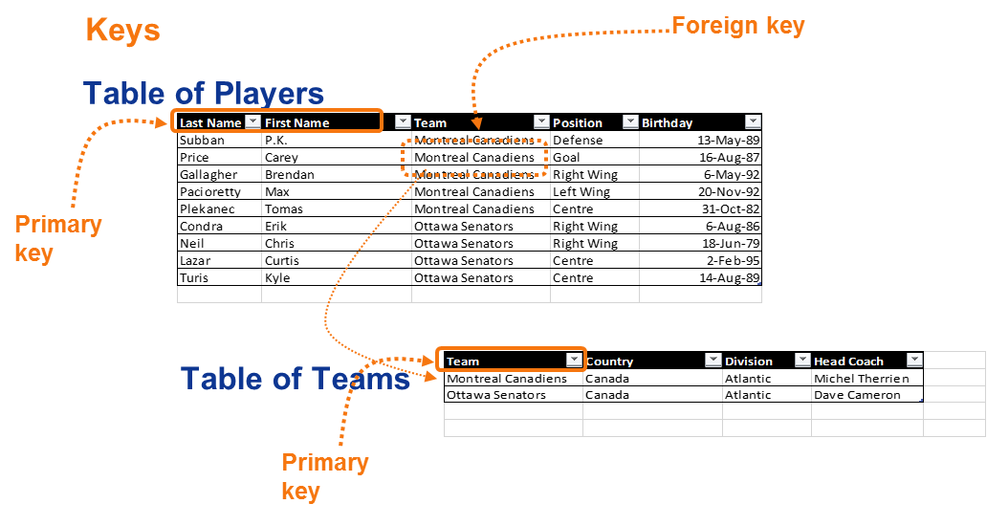
Firming up our terminology
Key
An identifier to find data in a table
Primary key
The main specifier for a row in a table
Foreign key
A field in a table that is used as a primary key for another table
Notes:
Under the hood, the RDMS will typically optimize for primary keys. You’ll be able to search more quickly on primary keys.

Slide 14
Example Actions on Tables
Add/Delete/Modify a row in software
What row?
How do you identify a row in your table? (key)
Pick elements in the row that makes that row unique
Single or compound “keys”
“modify the phone number where lastName is Chan, firstName is Richard”
Design challenge: what guarantees uniqueness?
Notes:
Now, I can have a system that I can automate.
I can collect data in a table, and perform adds, deletes, and modifies.
Class activity:
Create a database on the board with two tables, hockey player, team info (or similar)
Pair up and roles (client, DB server)
Assume DB exists and is populated already on the DB server
Client asks
Query, updates and deletes
Using syntax:
Query: Select from table TableName where fieldname=‘value’
Update: update table TableName where fieldname=‘value’ set fieldname2=‘value2’
Delete: delete from tableName where fieldname=‘value’;

Slide 15
Next steps – Hands-on
Database design – use case
Paper exercise
CASE tool
SQL
Language for: Definition, creation, querying, updating, administration of RDMS
Use SQL to implement your database design
Understanding what commercial RDMS do

